Slide 1

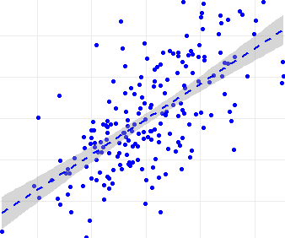
Biostatistics week 11 How to best use regression for prediction?

Slide 2
Topics of this lecture
Purpose of descriptive vs. predictive regression models
What data do we need for predictive modeling
Rigid vs flexible models: Underfitting/Overfitting or Bias/Variance
How to evaluate a predictive regression model: MSE on new data
Shrinkage of parameter in linear models help to get better predictions
Lasso or ridge regression yield good prediction models
Regression to the mean and why this matters in medicine
The best descriptive model is often not the best predictive model

Slide 3
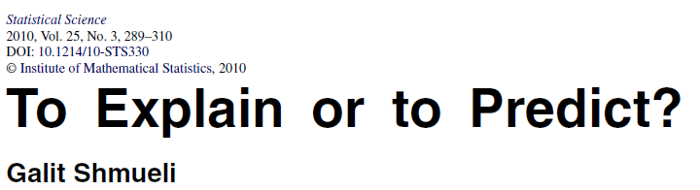
For what purpose do we develop a statistical model?
Description: Describe data by a statistical model.
Explanation: Search for the “true” model to understand and causally explain the relationships between variables and to plan for interventions.
Prediction: Use model to make reliable predictions.
Remember last lecture
Difficult with observational data – in medicine we do RCT to learn about causal effects
Main topic of today

Slide 4
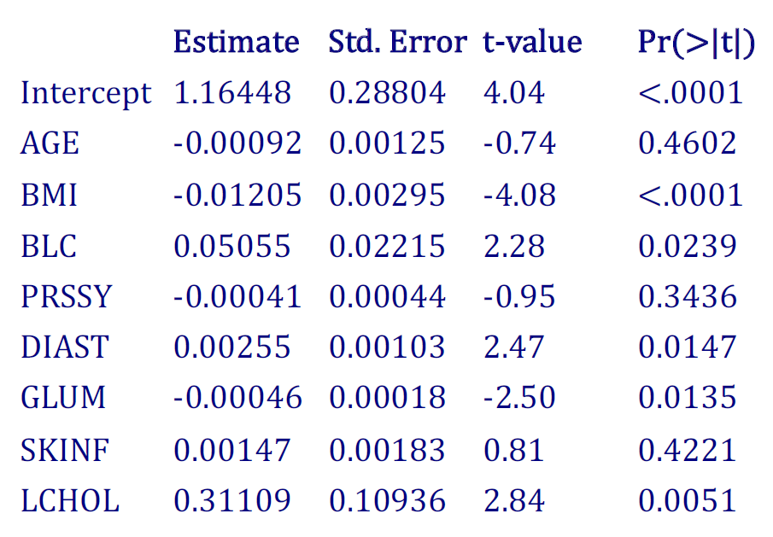
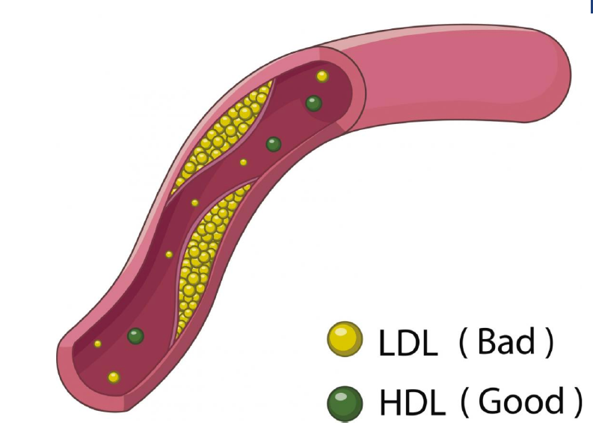
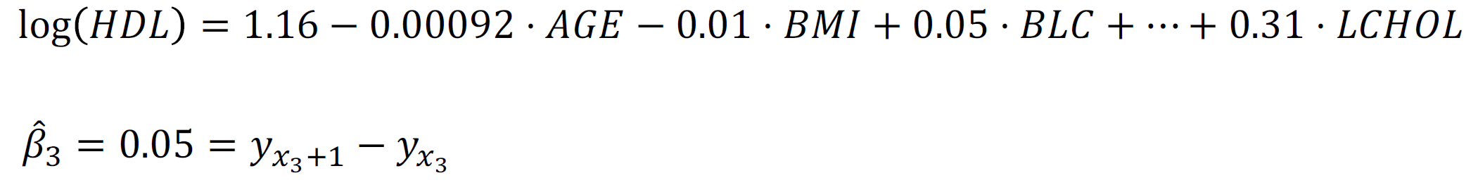
Descriptive modelling: we saw that last time
The coefficient β₃ gives the change of the outcome y=log(HDL), given the explanatory variable BLC_{k} is (vitamin in blood) is increased by one unit and all other variables are hold constant (usually not a realistic assumption).
Bad news: you can only estimate, but never “observe directly” the coefficient of a model.

Slide 5
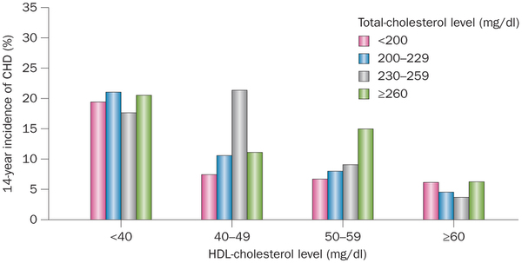
A warning ahead: A good predictive model may not be a good causal model
?
Heart disease
HDL
Epidemiological studies of CHD and the evolution of preventive cardiology
Nature Reviews Cardiology 11, 276–289 (2014)
HDL gives a strong negative association with heart disease in cross-sectional studies and is the strongest predictor of future events in prospective studies.
Prediction worked
Roche tested the effect of drug “dalcetrapib” in phase III on 15’000 patients which proved to boost HDL (“good cholesterol”) but failed to prevent heart diseases. Roche stopped the failed trial on May 2012 and immediately lost $5billion of its market capitalization.
Planned intervention failed
Notes:
http://www.totalscientific.com/biomarkerblog/?p=132 The HDL myth: how misuse of biomarker data cost Roche and its investors $5billion
On May 7th 2012, Roche terminated the entire dal-HEART phase III programme looking at the effects of their CETP inhibitor dalcetrapib in patients with acute coronary syndrome. The immediate cause was the report from the data management committee of the dal-OUTCOMES trial in 15,000 patients that there was now no chance of reporting a 15% benefit with the drug
CETP inhibitors boost HDL (the so-called “good cholesterol”) by inhibiting the Cholesterol Ester Transfer Protein (CETP), a key enzyme in lipoprotein metabolism. And they work! HDL cholesterol concentrations are doubled soon after beginning treatment, more than reversing the depressed HDL levels that are robustly associated with coronary heart disease (and indeed risk of death from a heart attack).
That was quite a firm enough foundation for developers to believe that CETP inhibitors had a golden future. After all, HDL is the “best” biomarker for heart disease. By that I mean that, of all the lipid measures, HDL gives the strongest association with heart disease in cross-sectional studies and is the strongest predictor of future events in prospective studies. Since we know lipids are important in heart disease (from years of clinical experience with statins), therefore elevating HDL with CETP inhibitors just HAS to work. Right?

Slide 6


Prediction is often easier than explanation
I saw such guys before and hearing these numbers the blood pressure is Y
He has a LDL of X1 which narrows your blood vessels beside that with his age of X2 their flexibility is reduced, so that I deduce a blood pressure of Y

Slide 7
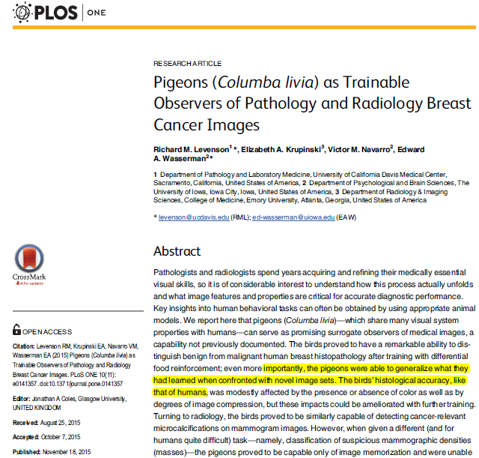
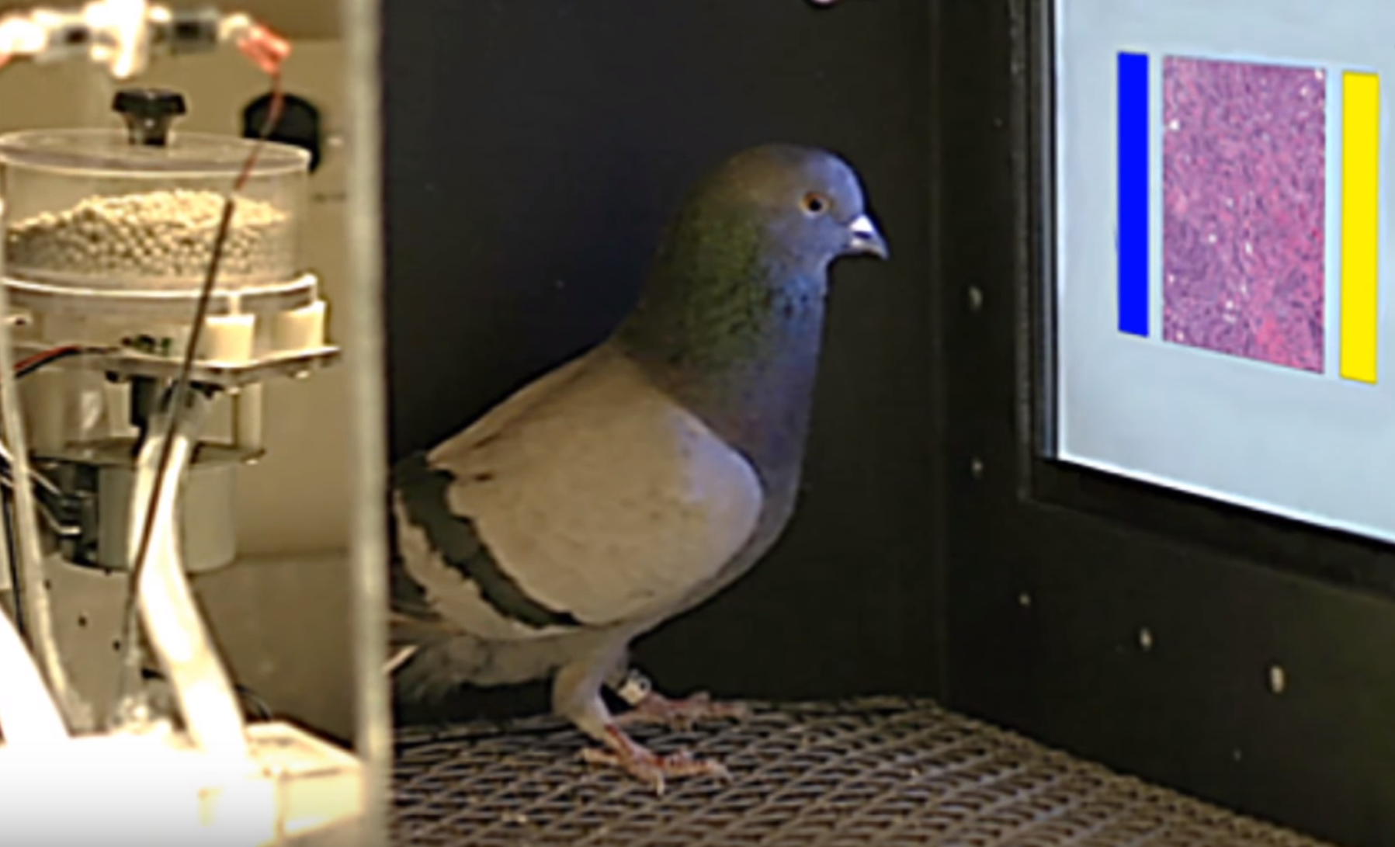
Prediction does not require understanding
https://www.youtube.com/watch?v=NsV6S8EsC0E
A single pigeon reaches up to 84% accuracy

Slide 8
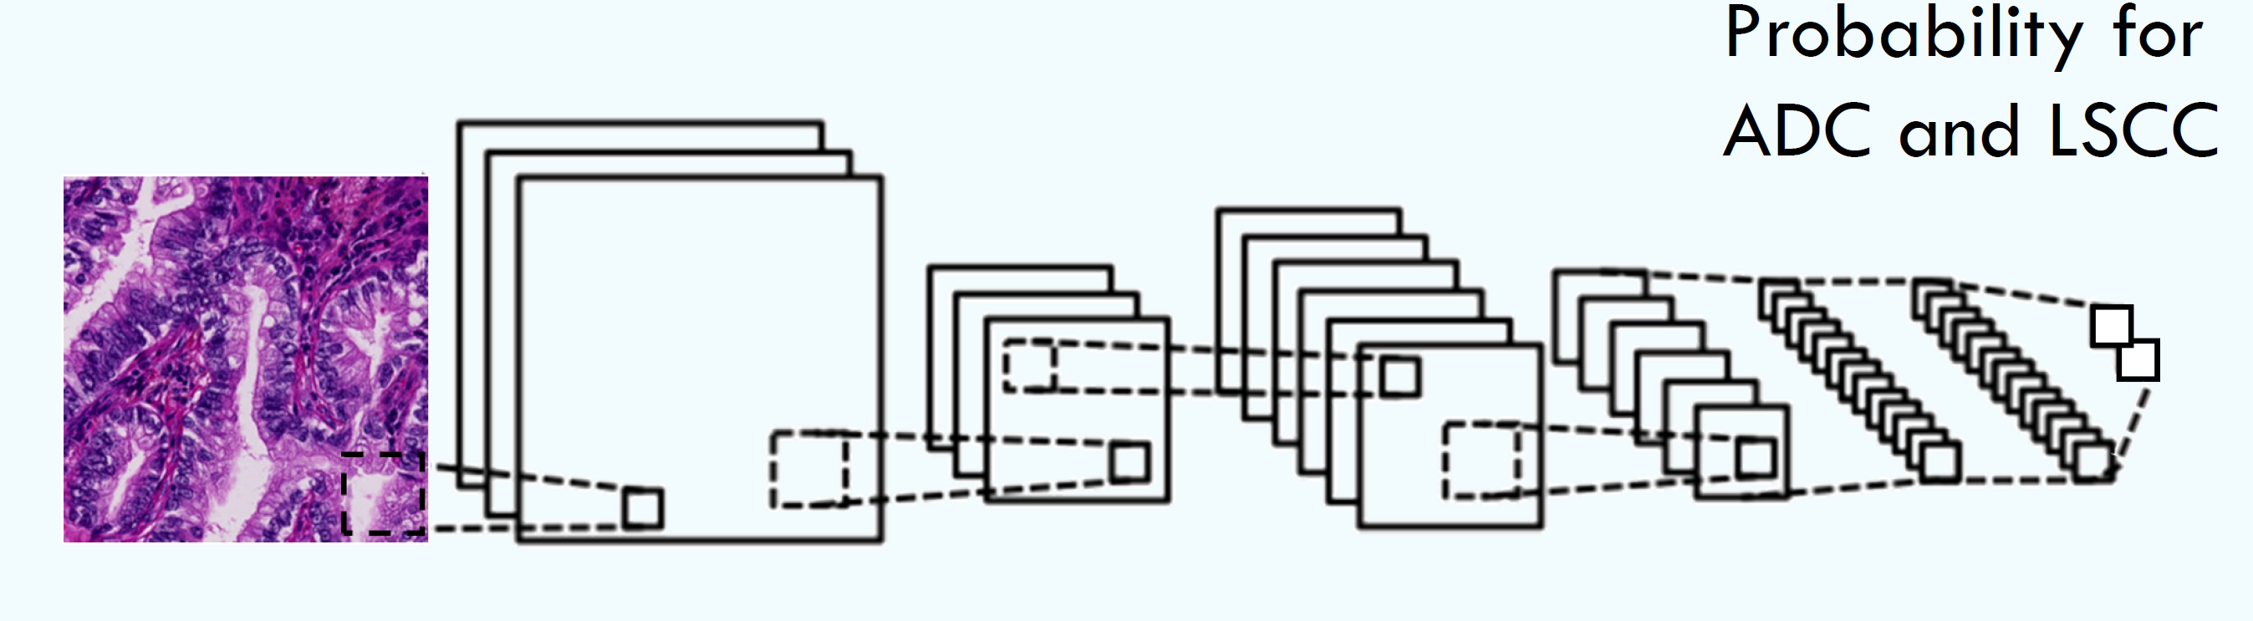

Predictive models are still not always easy to beat
Predictive model based on deep neural networks
Our DL model achieves ~90% accuracy on image level
A single pigeon: 84% accuracy
We as DL team ourselves struggle with the pigeon benchmark ;-)

Slide 9
Predictive modeling

Slide 10
What data do we need to build a prediction model?
We need to observe the outcome
We should observe as many potential predictors as possible
We should think about transforming the variables before fitting
We should collect the outcome and predictor variables for a large, representative patient sample, so that ideally ~30% is enough to fit a model that contains all predictors of interest and also some reasonable interactions, e.g.:

Slide 11
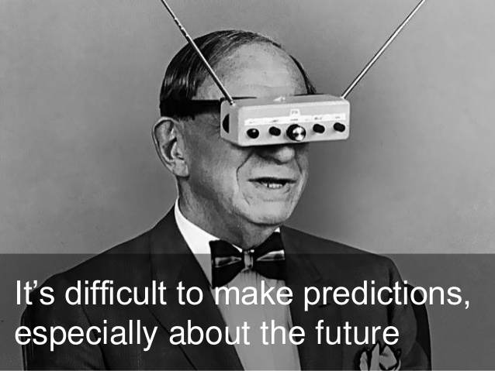
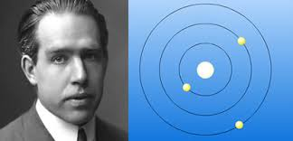
Predictive modeling
Nils Bohr, physics Nobel price 1922

Slide 12

What data do we need to evaluate a prediction model?
Always use new data, that were not used to build the model, to evaluate the predictive performance!
I never saw this guy but can still predict that she will tell his blood pressure is Y
Good news: for predictive models we can eventually observe the true value → we can directly check how good our predictions are

Slide 13
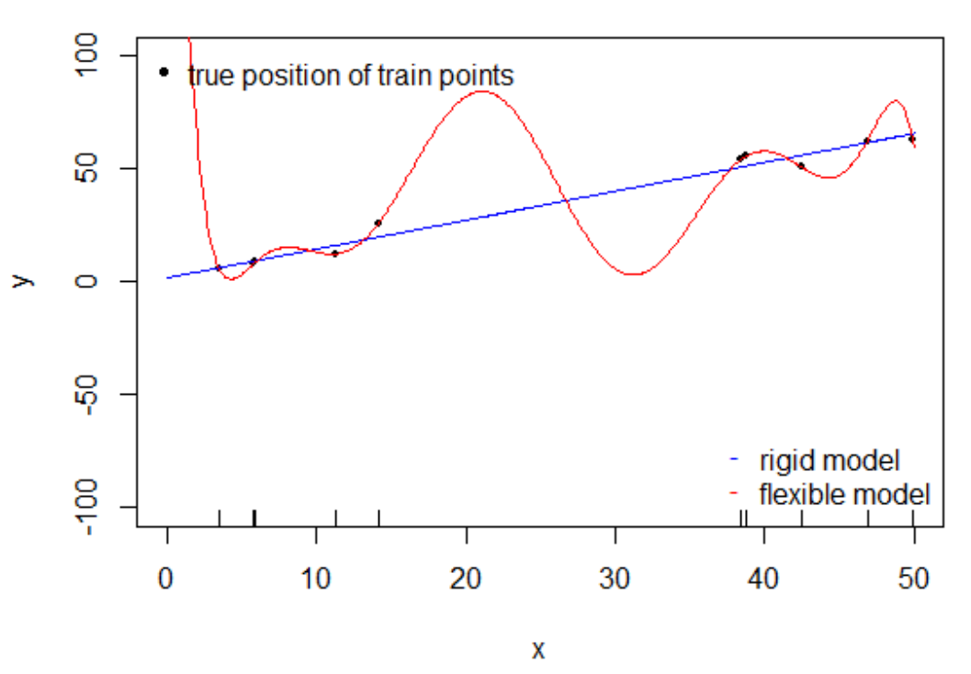
Which model will yield the better predictions?
fit.lin = lm(y~x, data=train)
fit.poly = lm(y~ poly(x, degree=9),data = train)
Since we simulate this data, we know the true relationship between x and y and can hence easily sample random training (and test) data which we can use to fit (and evaluate) a model.

Slide 14
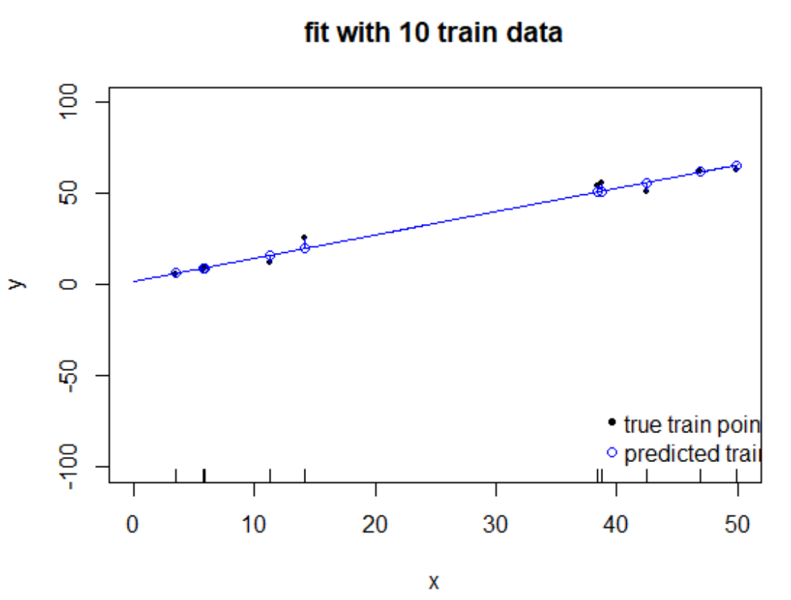
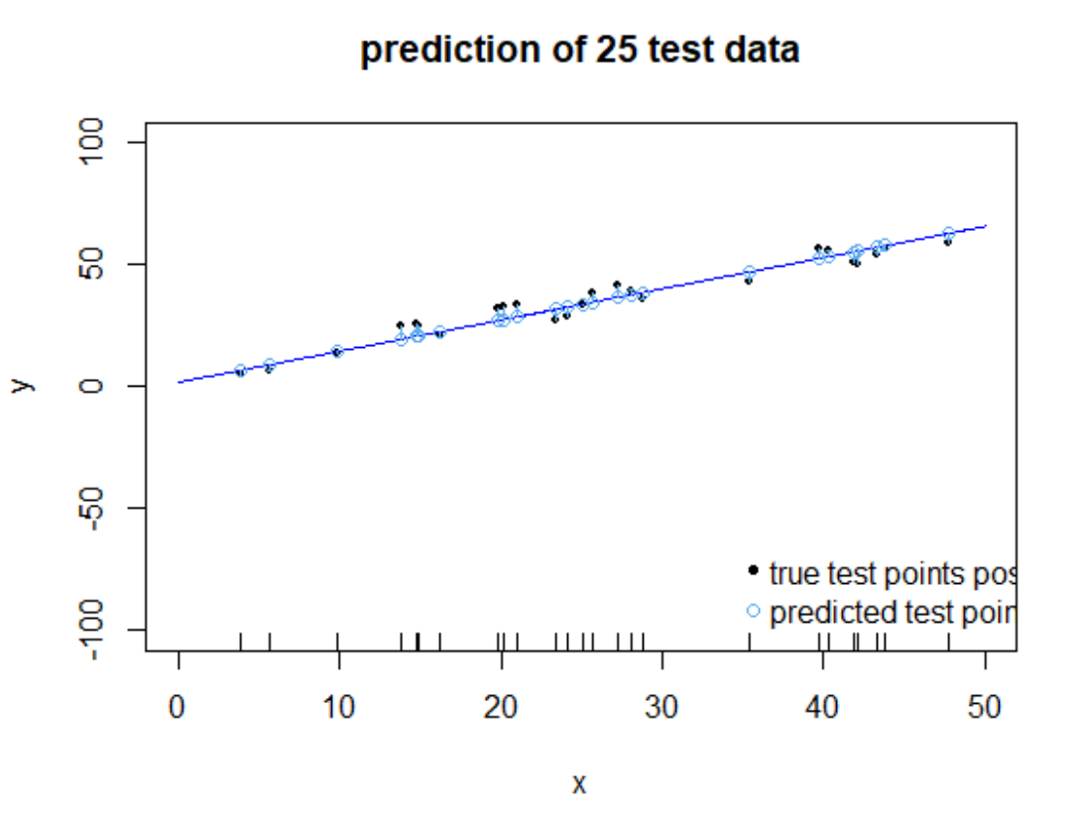
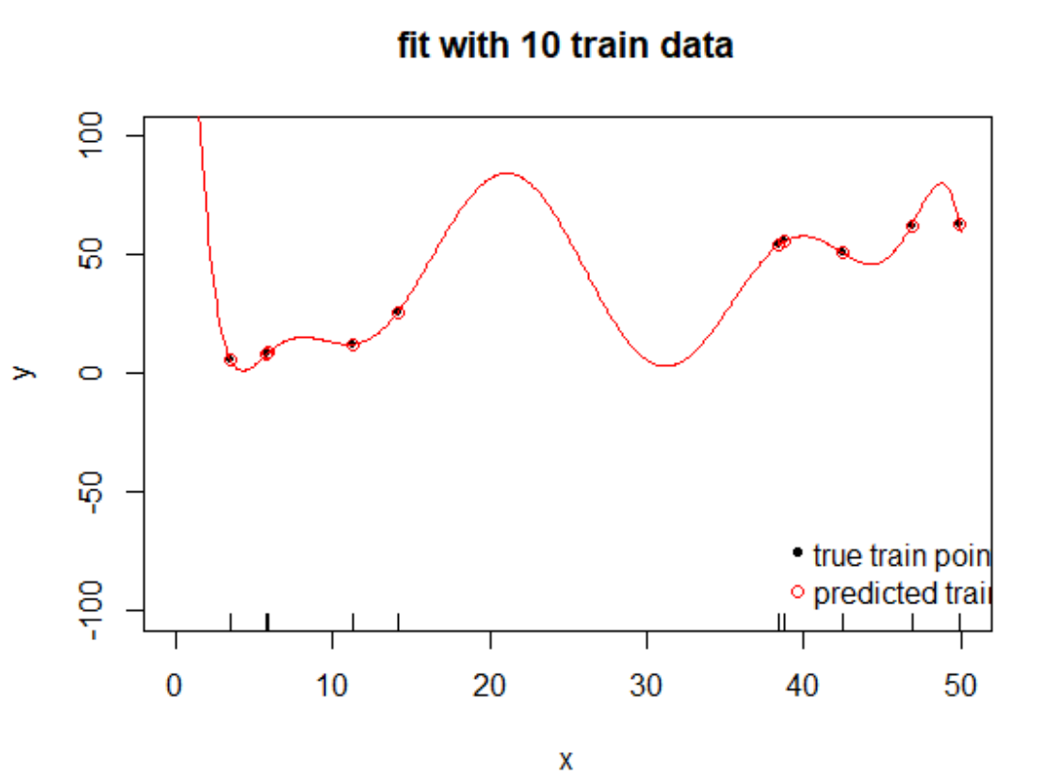
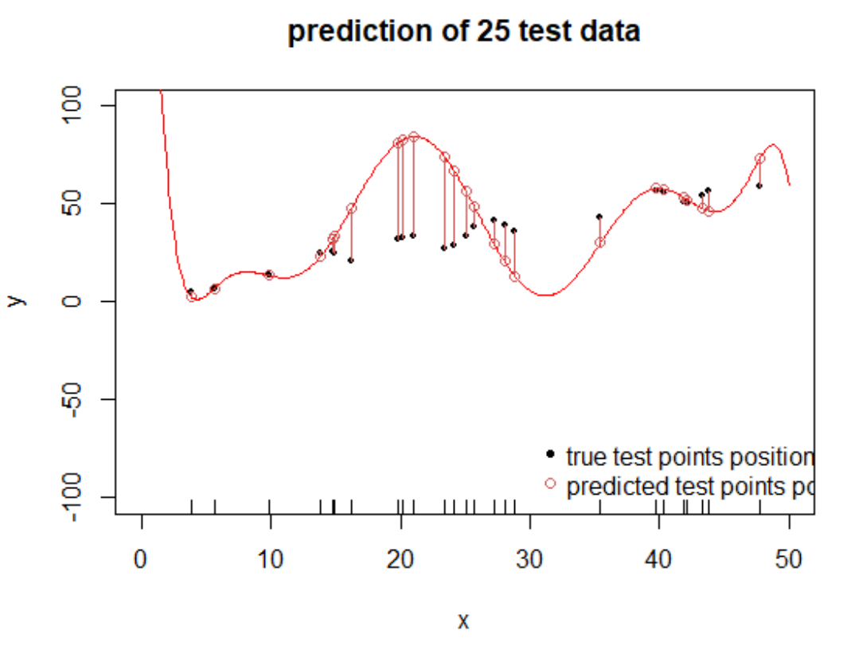
Compare flexible with ridge prediction model
Check performance on train data
Check performance on test data
Note: The flexible “overfits” the train data: its performance goes down on test data
The rigid model ofteh “underfits” the data: the true underlying relationship is more complex.

Slide 15
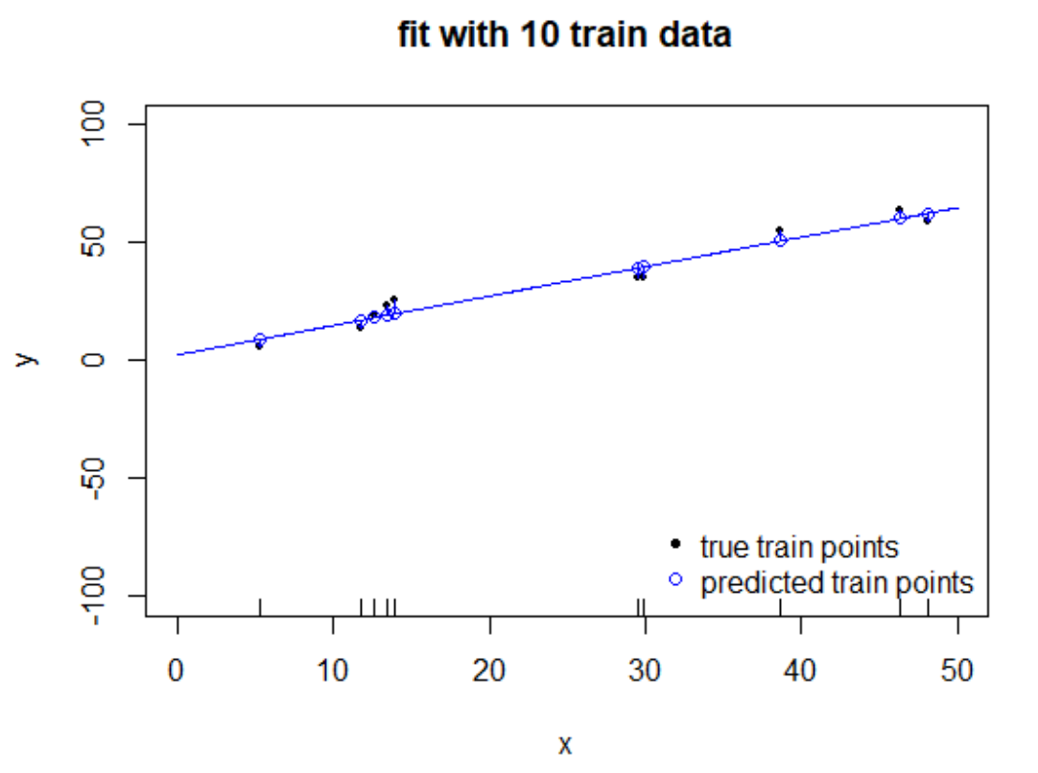
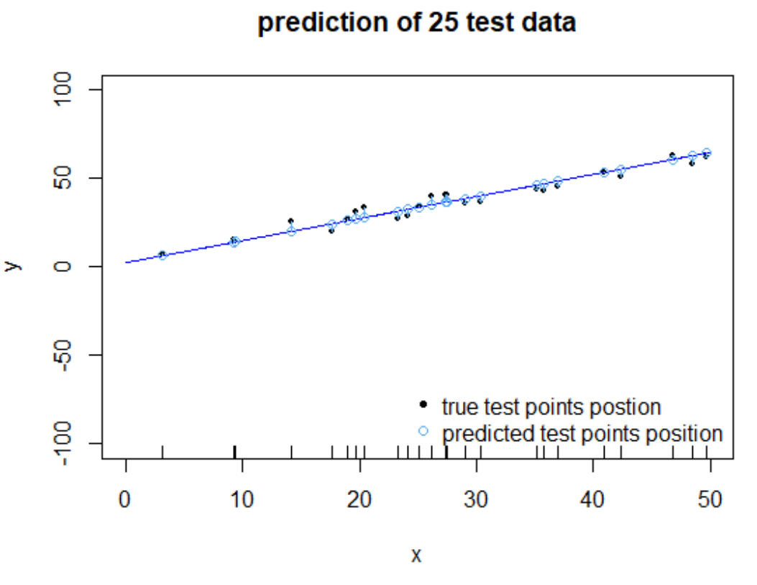
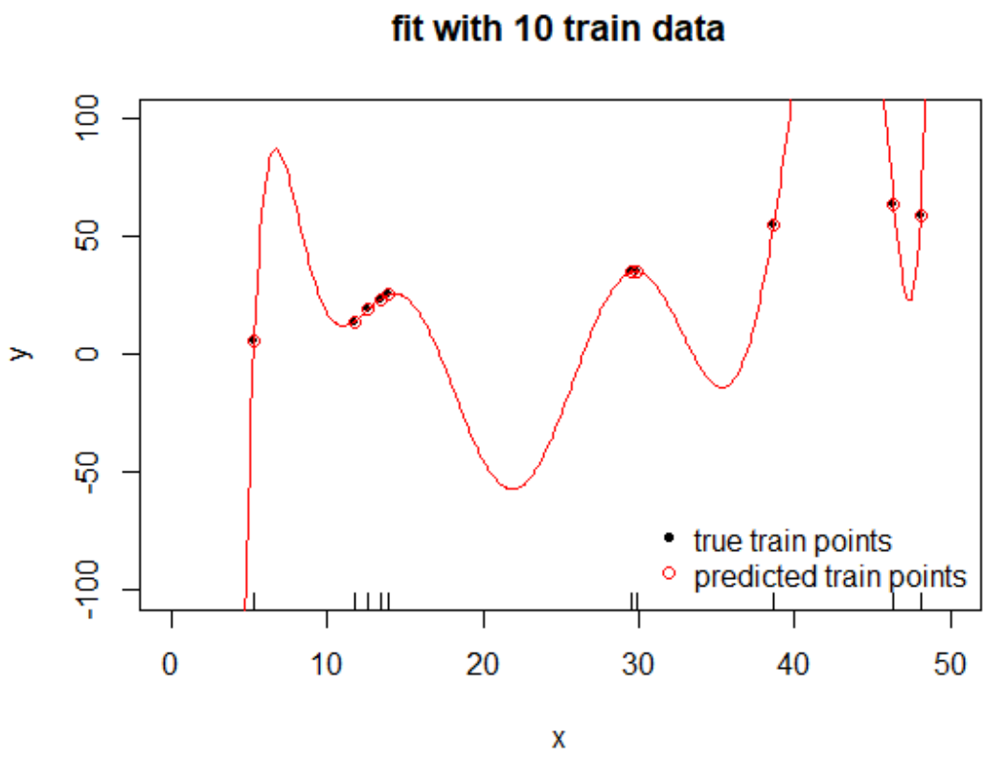
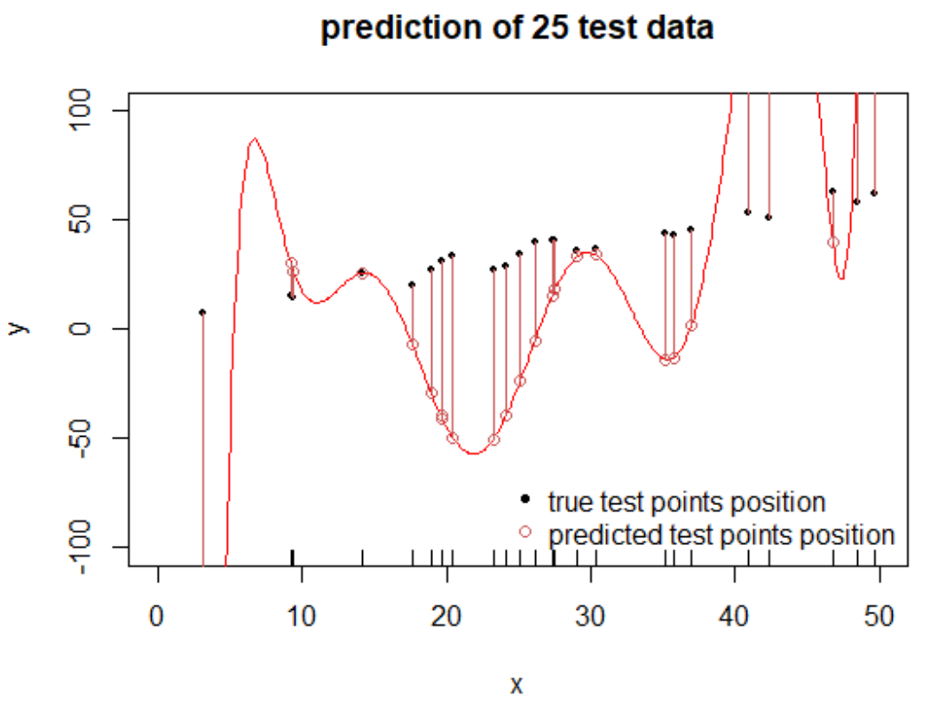
Get new train and test data and do all again
Check performance on train data
Check performance on test data
Note: The flexible model is on new train data very different to the run we saw before, the rigid model is very similar

Slide 16
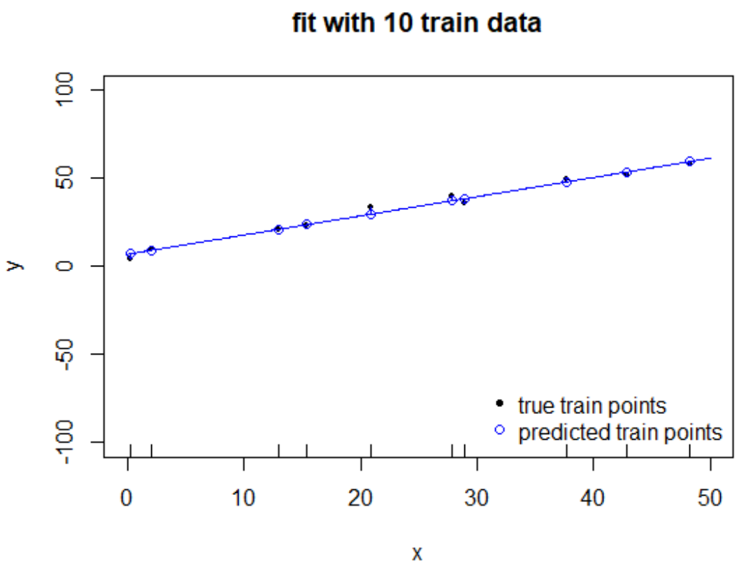
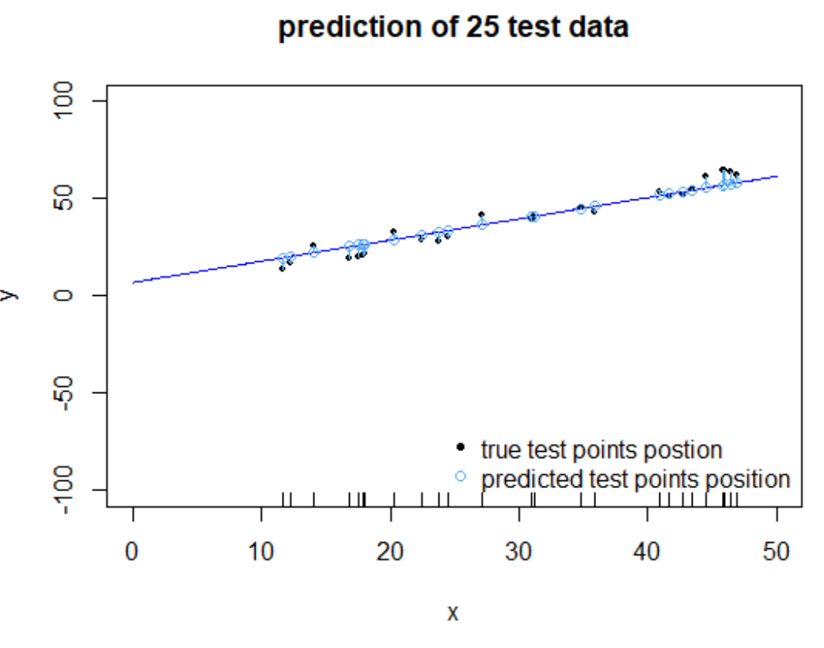
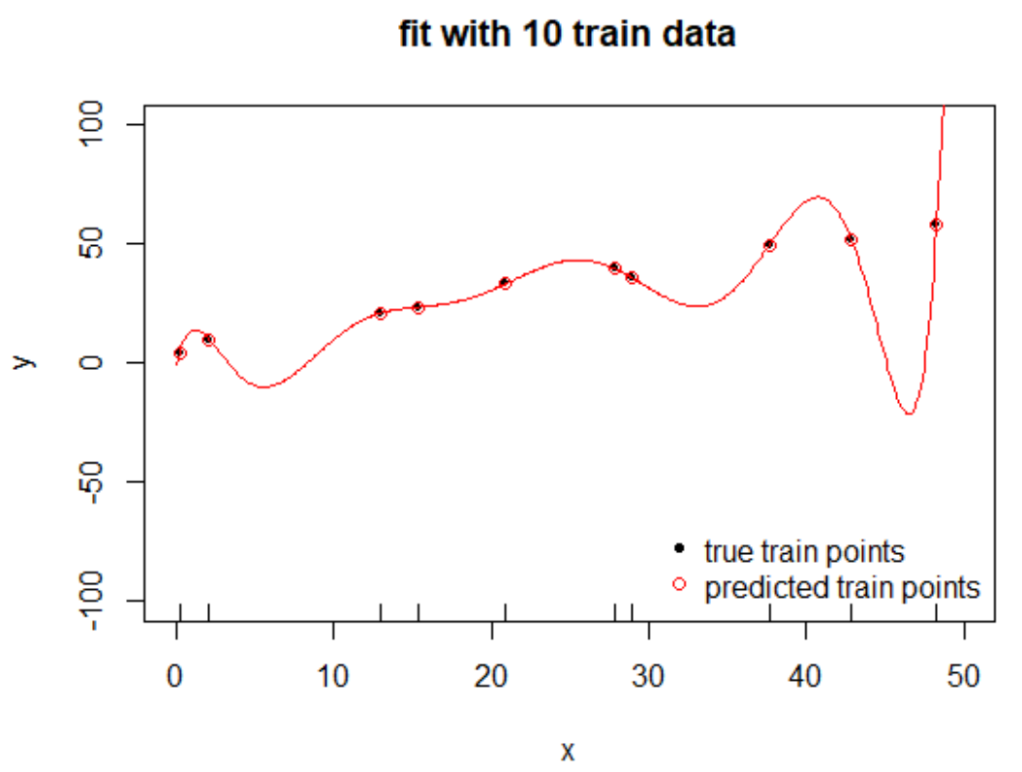
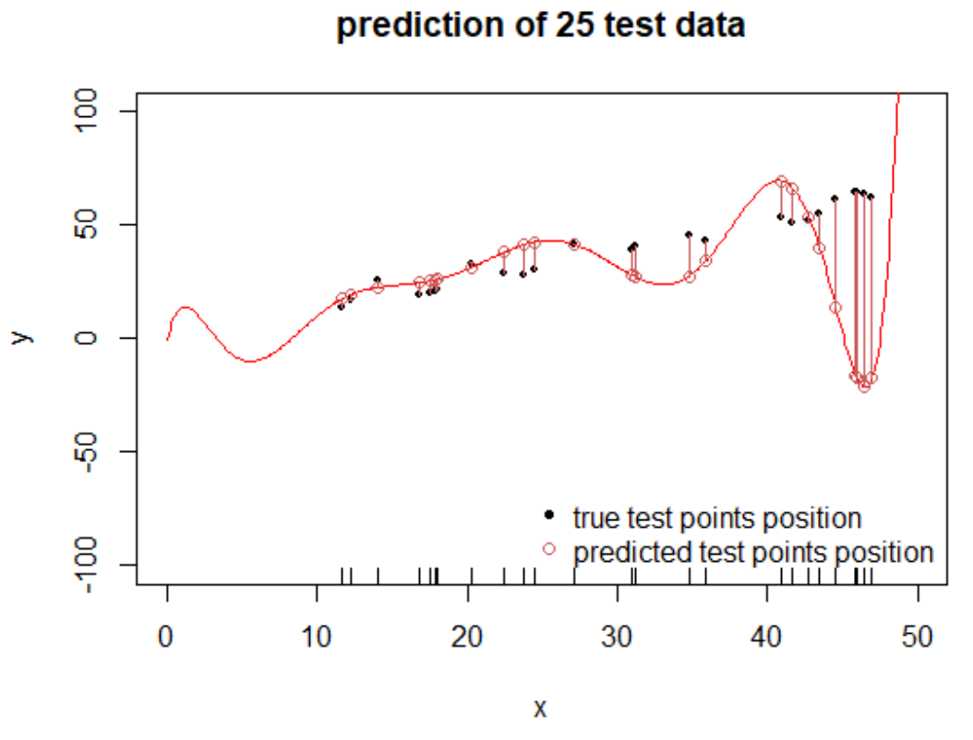
Get new train and test data and do all again
Check performance on train data
Check performance on test data
Note: The flexible model is on new train data very different to the run we saw before, the rigid model is very similar

Slide 17
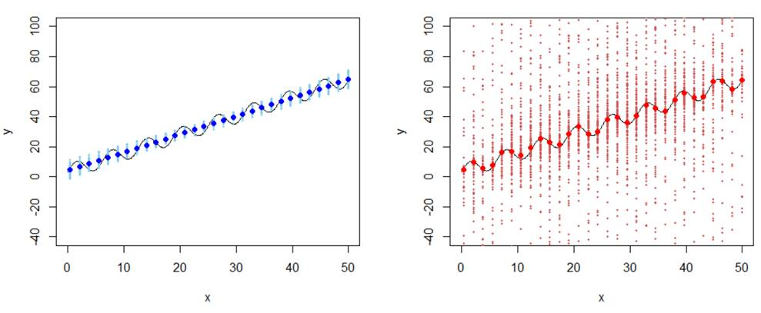
Variance/Bias trade-off of flexible/rigid models
Our simulated data came from an ascending oscillating curve – see grey curve.
We sample 200 times a train set of 10 points and fit both models.
We evaluate both models in all 200 runs at 30 pre-selected x-positions – see tiny points. We determine for both models at those x the mean of all 200 predictions – see fat points
Predictions of rigid model as much lower variance (see variation of tiny points)
The mean predictions (fat points) of the rigid model has more systematic error = bias
- underlying truth
- underlying truth
Underfitting
Low Variance
Large Bias
Overfitting
High Variance
Small Bias

Slide 18
Which model gives better predictions? We need to do a Variance/Bias trade-off
- underlying truth
- underlying truth
Underfitting
Low Variance
Large Bias
Overfitting
High Variance
Small Bias
Here we probably would choose the rigid model, since here we can expect, that a (single) model, that we did fit to 10 train data points lead on test data predictions, that are quite close to the true value.

Slide 19
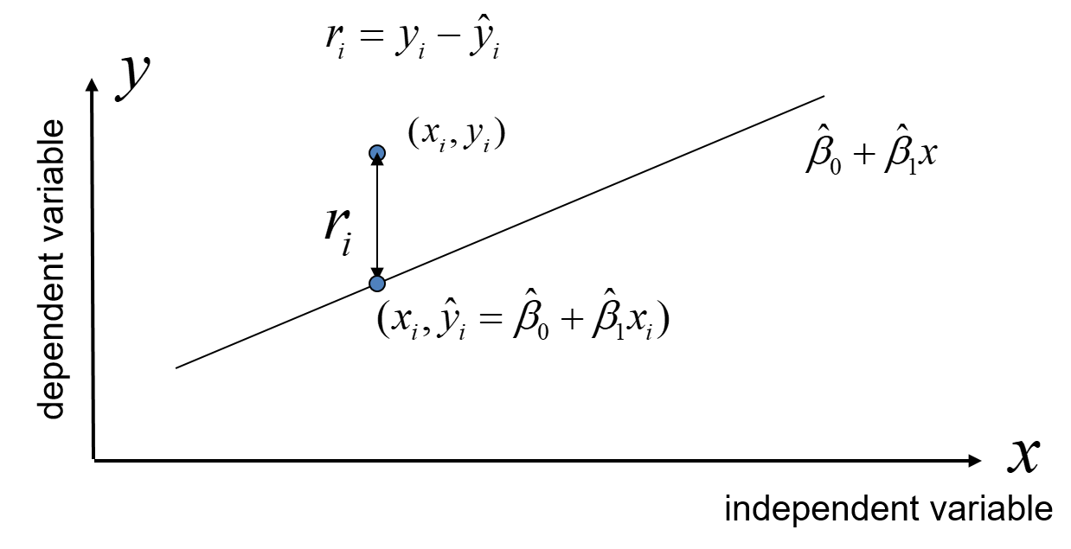
How to quantify the prediction performance of one specific model?
We use the test error and determine:
- the mean square error (MSE) or root mean square error (RMSE):
- the mean absolute error (MAE):
- the mean absolute percentage error (MAPE)

Slide 20
A simple example in R: Splitting data in train and test
dat=cars # this data set is part of standard R
head(dat) # display head of data.frame
#> speed dist
#> 1 4 2
#> 2 4 10
# ...
# Randomly split data into Training and Test data
set.seed(100) # for reproducibility
# row indices for training data
trainingRowIndex <- sample(1:nrow(dat), 0.8*nrow(dat))
# train data set:
train <- dat[trainingRowIndex, ]
# test data set:
test <- dat[-trainingRowIndex, ]
Inspired by: http://r-statistics.co/Linear-Regression.html

Slide 21
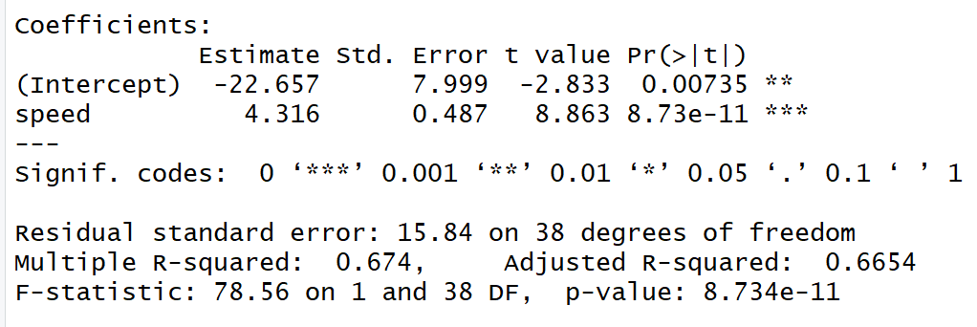
A simple example in R: fitting a linear regression model
# Build the model on training data -
lmMod <- lm(dist ~ speed, data=train) # build the model
# we get some performance measure from the summary output
summary(lmMod)
…
Peformance metrics to evaluate the fit on the training data
Remark: Do residual analysis to check that the model assumptions are not violated.
Inspired by: http://r-statistics.co/Linear-Regression.html

Slide 22
A simple example in R: determine predictions on test data
# predict dist on test data
test$distPred <- predict(lmMod, newdata=test)
# test data with added column holding predictions
speed dist distPred
1 4 2 -5.392776
4 7 22 7.555787
8 10 26 20.504349
20 14 26 37.769100
26 15 54 42.085287
31 17 50 50.717663
37 19 46 59.350038
39 20 32 63.666225
40 20 48 63.666225
42 20 56 63.666225
Inspired by: http://r-statistics.co/Linear-Regression.html

Slide 23
A simple example in R: determine MSE, MAPE for test data
# predict dist on test data
test$distPred <- predict(lmMod, newdata=test)
# determine MSE and MAPE of test predictions:
MSE <- mean((test$dist - test$distPred)^2)
MAPE <- mean(abs((test$distPred - test$dist))/test$dist)
MSE
205.9653
MAPE
0.6995032
Performance metrics to evaluate the predictions on the test data
Inspired by: http://r-statistics.co/Linear-Regression.html

Slide 24
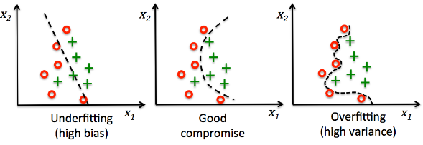
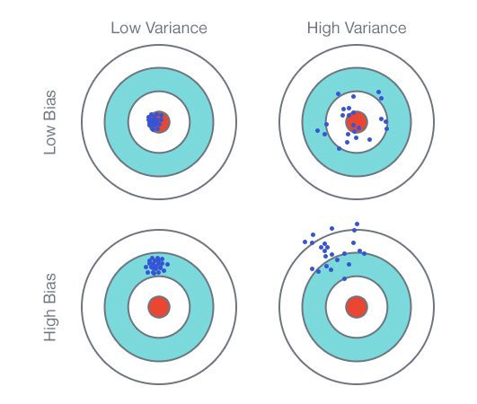
The concept of Bias and Variance of a regression model
A under fitting model
is not flexible enough for true data structure
Some systematic error since the model assumes a too simple relationship (high bias)
will not vary a lot if fitted to new train data (low variance)
A overfitting model
is too flexible for data structure
few errors on train set and non-systematic test errors (low bias)
will vary a lot if fitted to new train data (high variance)

Slide 25
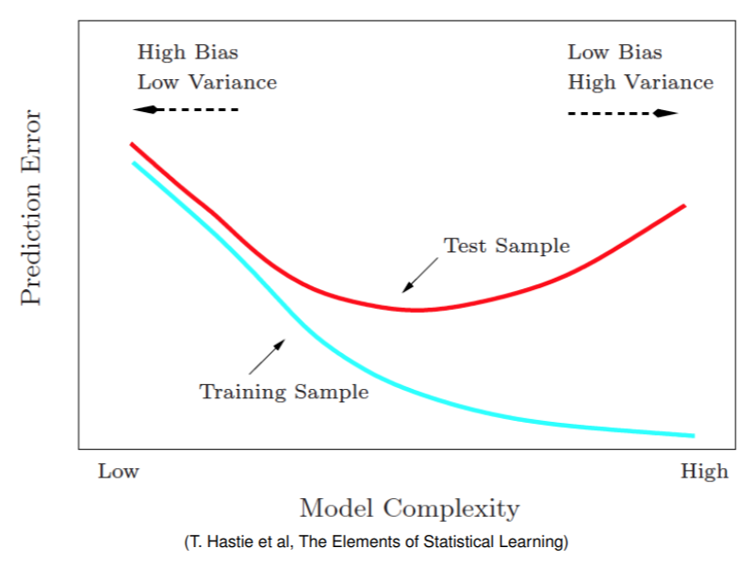
The concept of Bias and Variance tradeoff
See exercises for a more detailed discussion of this plot.

Slide 26
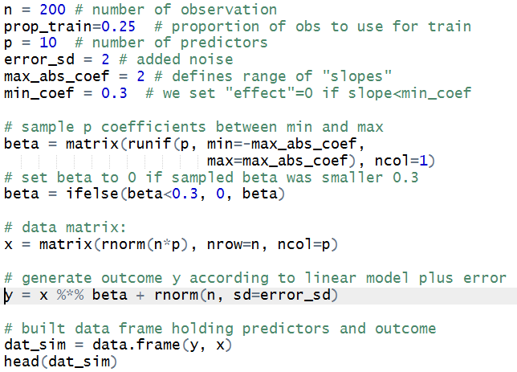
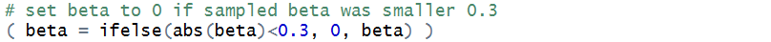
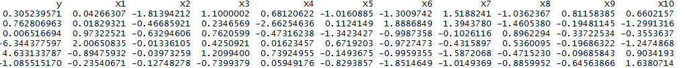
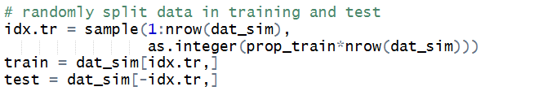
Let’s simulate some data and split them in train and test set
…
26

Slide 27
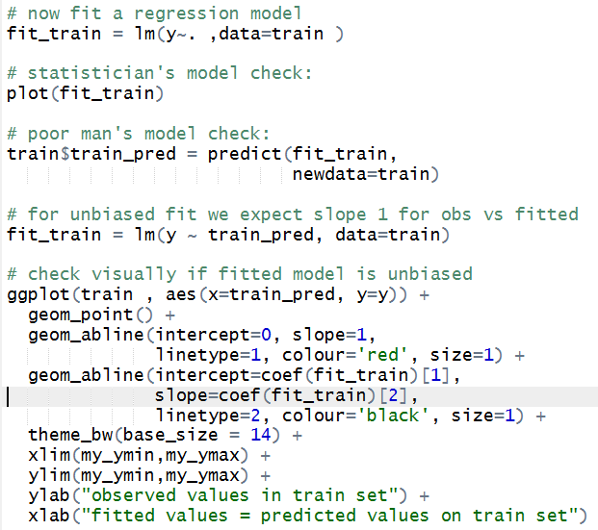
Let’s fit a linear regression model for descriptive modelling
27

Slide 28
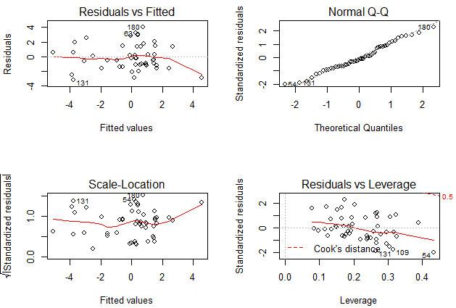
Statisticians descriptive model check: residual analysis
Residual plots look o.k., what is expected since true model is fitted to simulated data.
28

Slide 29
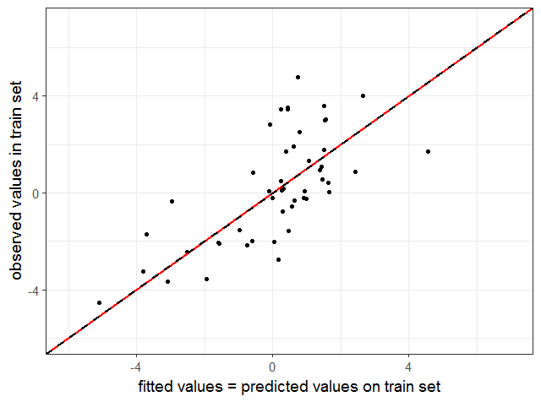
Poor man’s descriptive model check: observed vs fitted
main diagonal
fitted regression line y~predicted for train data
Slope of fitted line for observed vs fitted is 1 proving that linear regressions produces unbiased fitted values.
29

Slide 30
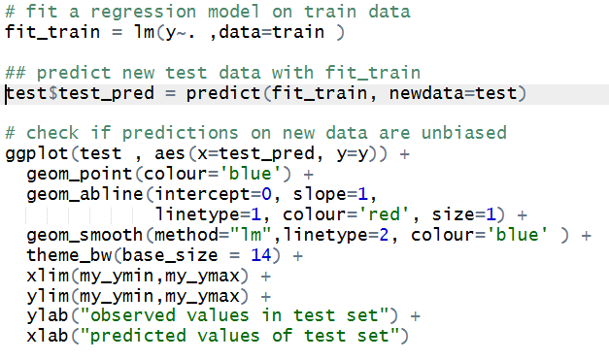
Let’s use the regression model as predictive model
30

Slide 31
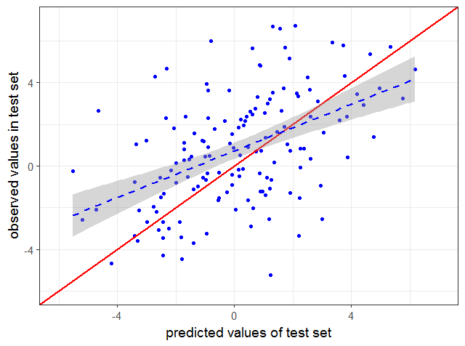
Let’s check if predictions are unbiased: calibration plot
main diagonal
fitted regression line y~predicted for test data
Slope of fitted line for observed vs predicted values is smaller that 1 meaning that linear regressions produces to extreme predicted values.
31

Slide 32
Are predictions always to extreme?
The simulation shows that on average linear regressions produces to extreme predicted values. But we have sample variation and the bias varies from run to run and sometimes the predictions are even not extreme enough.
32

Slide 33
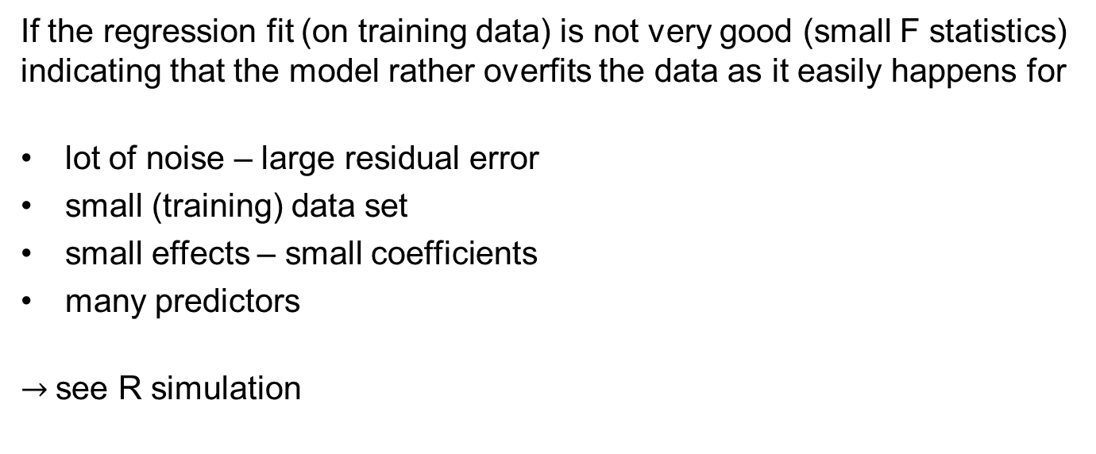
In which cases are “naïve” predictions biased on new data?
If the regression fit (on training data) is not very good (small F statistics) indicating that the model rather overfits the data as it easily happens for
lot of noise – large residual error
small (training) data set
small effects – small coefficients
many predictors
$→$see R simulation
Observations in R simulation:
For p>=2 predictors and small effects we can observe this bias in the predictions (mean calibration slope b is significantly smaller than 1 when using the a model fitted on train to predict test data)
For p=1 predictor (simple regression) we cannot estimate the expected value of the calibration slope b to show b <1
The distribution of the simulated calibration slopes is not Normal but is rather compatible with a t-distribution with df=p
Houwelingen2001 p.25: “It might be expected that shrinkage in the regression setting only works if there are at least three covariates yielding four unknown parameters.”
33

Slide 34
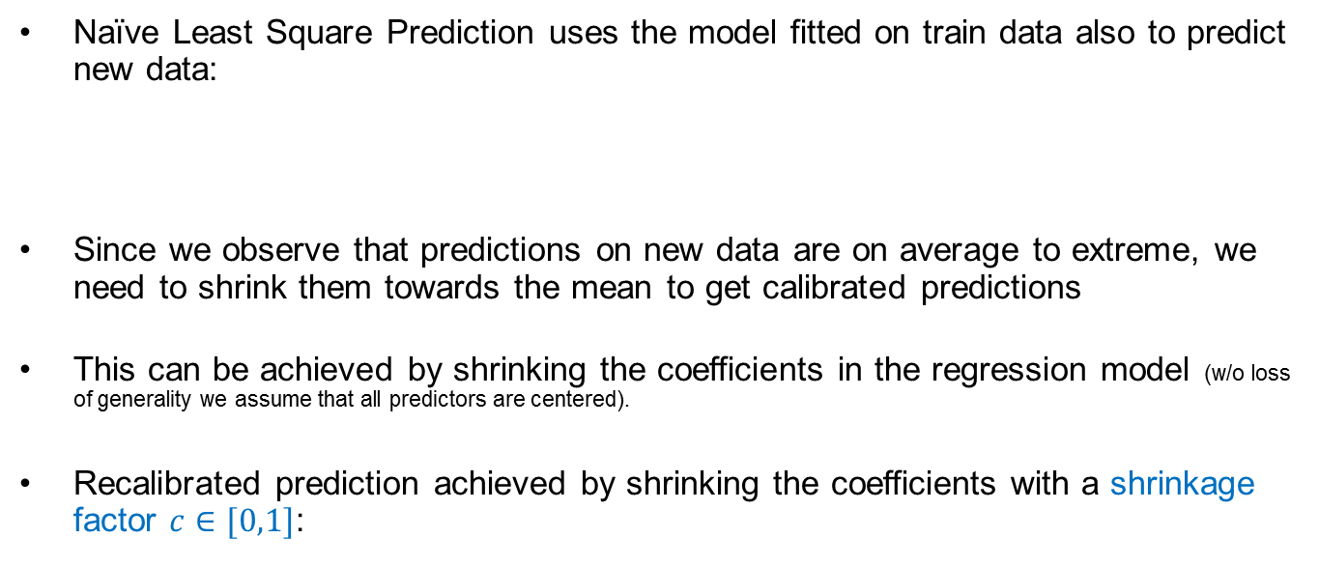
Shrinkage leads to calibrated predictions on new data
Naïve Least Square Prediction uses the model fitted on train data also to predict new data:
Since we observe that predictions on new data are on average to extreme, we need to shrink them towards the mean to get calibrated predictions
This can be achieved by shrinking the coefficients in the regression model (w/o loss of generality we assume that all predictors are centered).
Recalibrated prediction achieved by shrinking the coefficients with a shrinkage factor $c∈[0,1]$:
34

Slide 35
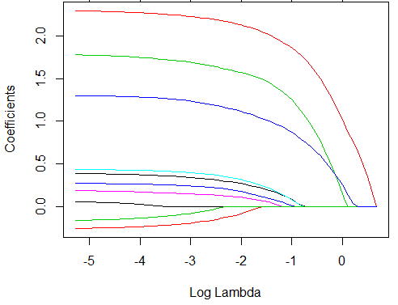
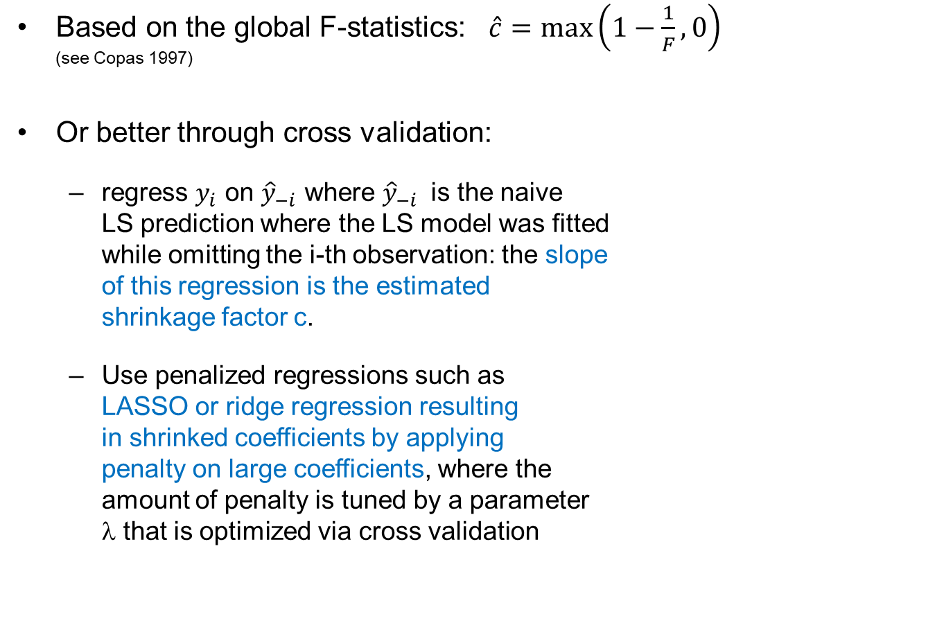
How to determine how much we need to shrink the coefficients?
Based on the global F-statistics: $\hat{c}=\max\left(1−\frac{1}{F},0\right)$ (see Copas 1997)
Or better through cross validation:
regress $y_{i}$ on ${\hat{y}}_{−i}$ where ${\hat{y}}_{−i}$ is the naive LS prediction where the LS model was fitted while omitting the i-th observation: the slope of this regression is the estimated shrinkage factor c.
Use penalized regressions such as LASSO or ridge regression resulting in shrinked coefficients by applying penalty on large coefficients, where the amount of penalty is tuned by a parameter λ that is optimized via cross validation
main diagonal
fitted regression line
35

Slide 36
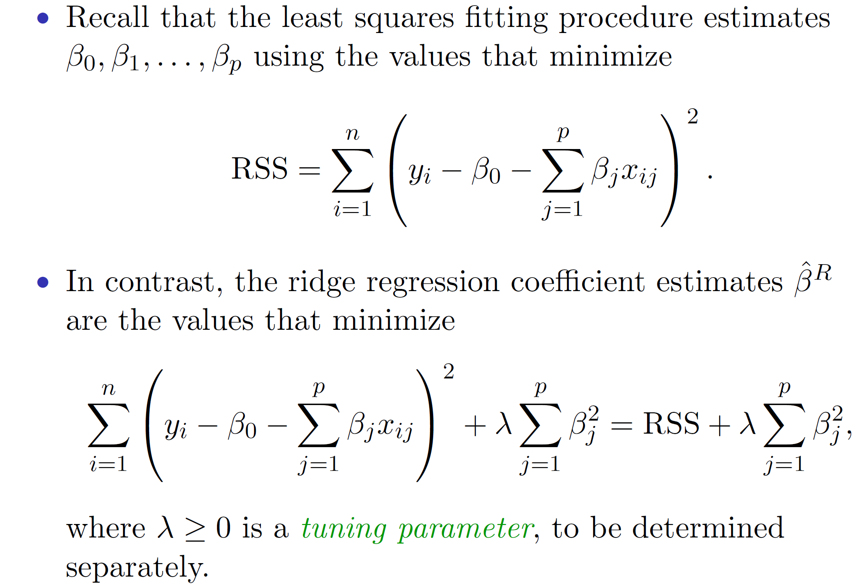
Ridge regression
ISLR chapter 6 slides Hastie Tibshirani

Slide 37
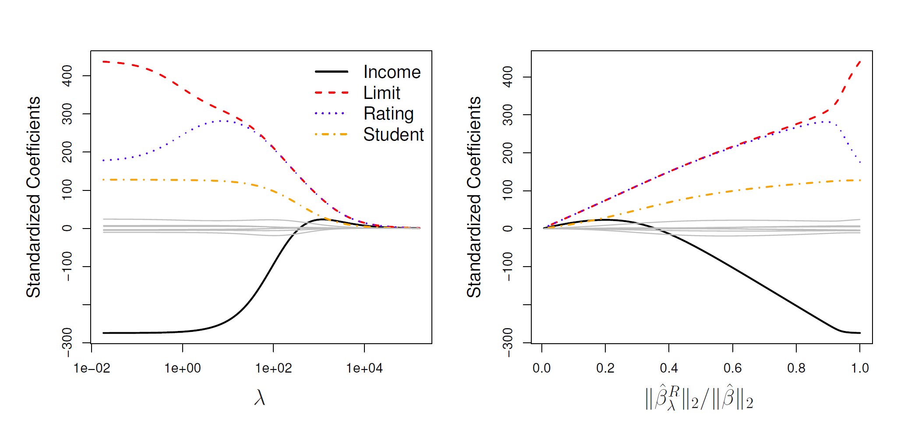
Coefficient paths when tuning penalty in Ridge Regression
ISLR chapter 6 slides Hastie Tibshirani

Slide 38
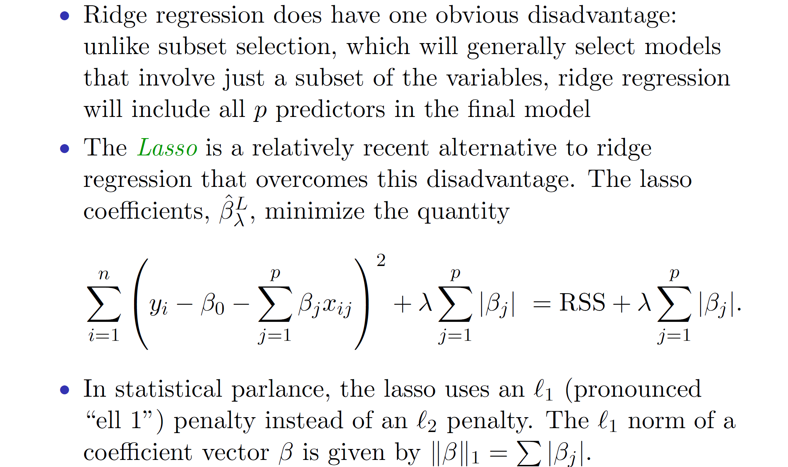
Going from ridge regression to Lasso
ISLR chapter 6 slides Hastie Tibshirani

Slide 39
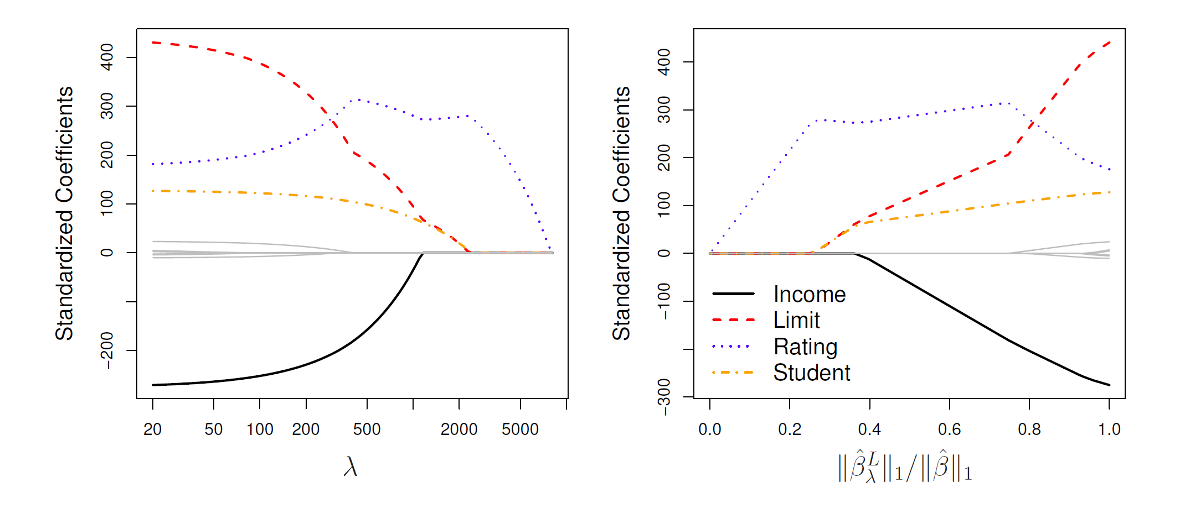
Coefficient paths when tuning penalty in Ridge Regression
ISLR chapter 6 slides Hastie Tibshirani

Slide 40
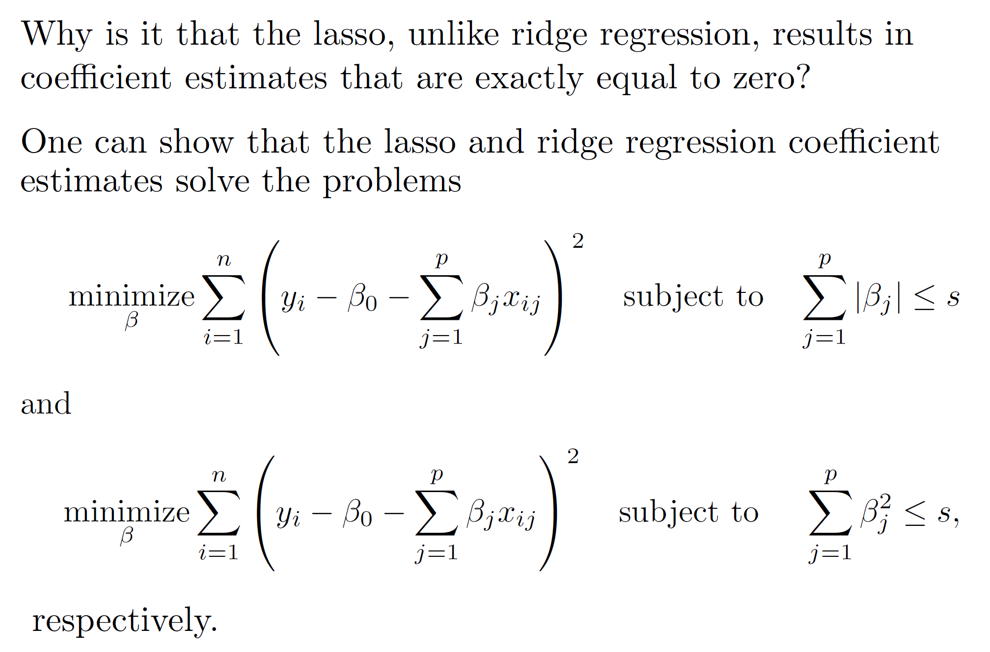
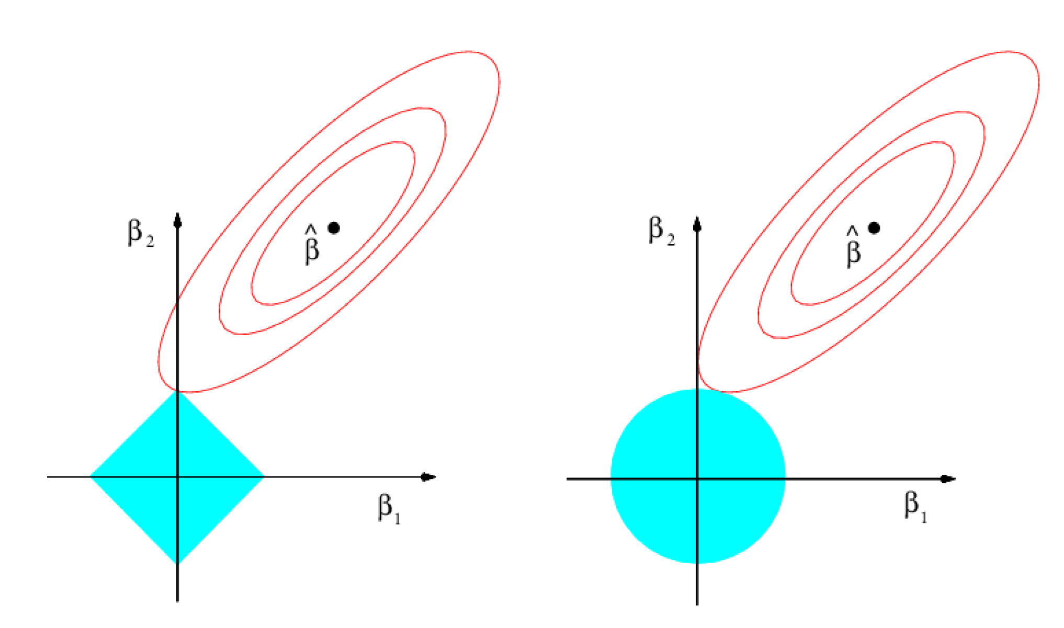
Geometric interpretation of objective in ridge and lasso
optimal OLS β
Compromize to minimize sum of both contribitions
The point of compromise, where the sum of both loss components is minimal is for lasso often on an axis where one coefficient is zero – for ridge this is not likely to be the case.

Slide 41
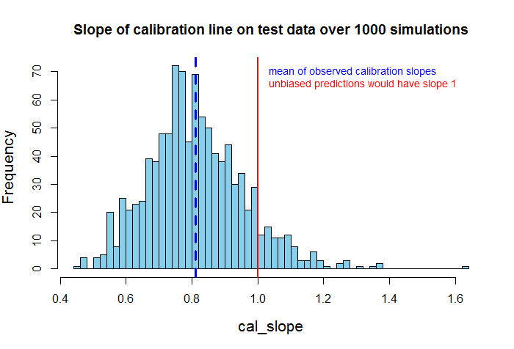

Compare calibration of LS-lm versus cv-lasso model
(unshrinked) LS lm model
cv-shrinked lasso model
The linear model from the simulation (10 predictors) is better calibrated after Lasso shrinkage.
library(glmnet)
fit_lasso = glmnet(x=X, y=Y, alpha=1)
plot(fit_lasso, xvar = "lambda")
crossval = cv.glmnet(x=X, y=Y)
plot(crossval)
opt_la = crossval$lambda.min
fit1 = glmnet(x=X, y=Y, alpha=1,
lambda=opt_la )
41

Slide 42


Calibration slope for train and test predictions
Using the model that was fitted on training set for prediction we get:
always a calibration-slope = 1
when predicting training data
on average a calibration-slope < 1
when predicting test data
42

Slide 43
Regression to the mean

Slide 44

Where does the term “regression” come from?
The concept of regression comes from genetics and was popularized by Sir Francis Galton during the late 19th century with the publication of Regression towards mediocrity in hereditary stature.
Galton observed that extreme characteristics (e.g., height) in parents are not passed on completely to their offspring. Rather, the characteristics in the offspring regress towards a mediocre point (a point which has since been identified as the mean).
Source: https://en.wikipedia.org/wiki/Francis_Galton
44

Slide 45


Galton’s discovery of the regression line
Remark: Correlation of IQs of parents and children is only 0.42 https://en.wikipedia.org/wiki/Heritability_of_IQ
slope 1
IQ distribution in sons with E(IQ_{sons})=112 with IQ_{fathers}=115
IQ of sons
Groups of fathers with IQ=115
IQ of fathers
For each group of father with fixed IQ, the mean IQ of their sons is closer to the overall mean IQ (100) -> Galton aimed for a causal explanation.
All these predicted E(IQ_{son}) fall on a “regression line” with slope<1.
Image credits (changed): https://www.youtube.com/watch?v=aLv5cerjV0c
Notes:
Galton stumbled on an important fact: the predictions always fall on a line, which he called the regression line.
Pearl, Judea. The Book of Why: The New Science of Cause and Effect (S.60-61). Basic Books. Kindle-Version. Sons of tall men tend to be taller than average—but not as tall as their fathers. Sons of short men tend to be shorter than average—but not as short as their fathers. Galton first called this phenomenon “reversion” and later “regression toward mediocrity.” This phenomena of regression to the mean is valid for each pair of not perfectly correlated random variables.
Extension to >2 dim: The analogue of a regression line is a regression plane, which has an equation that looks like Y = aX + bZ + c. We can easily compute a, b, c from the data. Here something wonderful happens, which Galton did not realize but Karl Pearson and George Udny Yule certainly did. The coefficient a gives us the regression coefficient of Y on X already adjusted for Z. (It is called a partial regression coefficient and written rYX.Z.)
generations of researchers came to believe that adjusted (or partial) regression coefficients are somehow endowed with causal information that unadjusted regression coefficients lack. Nothing could be further from the truth. Regression coefficients, whether adjusted or not, are only statistical trends, conveying no causal information in themselves.
Pearl, Judea. The Book of Why: The New Science of Cause and Effect (S.222-223). Basic Books. Kindle-Version.
Pearl, Judea. The Book of Why: The New Science of Cause and Effect (S.222). Basic Books. Kindle-Version.

Slide 46
Galton’s discovery of the regression to the mean phenomena
IQ distribution in fathers with E(IQ_{fathers})=112 with IQ_{sons}=115
IQ of fathers
Groups of sons with IQ=115
IQ of sons
After switching the role of sons’s IQ and father’s IQ, we again see that E(IQ_{fathers}) fall on the regression line with the same slope <1.
There is no causality in this plot -> causal thinking seemed unreasonable.
Image credits (changed): https://www.youtube.com/watch?v=aLv5cerjV0c
Notes:
Sons of tall men tend to be taller than average—but not as tall as their fathers. Sons of short men tend to be shorter than average—but not as short as their fathers. Galton first called this phenomenon “reversion” and later “regression toward mediocrity.” This phenomena of regression to the mean is valid for each pair of not perfectly correlated random variables.

Slide 47







Pearson’s mathematical definition of correlation unmasks “regression to the mean” as statistical phenomena
After standardization of the RV:
Regression line equation:
$β_{1}$ quantifies regression to the mean
The correlation c of a bivariate Normal distributed pair of random variables are given by the slope of the regression line after standardization!
c quantifies strength of linear relationship
and is only 1 in case of deterministic relationship.
Notes:
https://en.wikipedia.org/wiki/Regression_analysis
The earliest form of regression was the method of least squares, which was published by Legendre in 1805,^{[7]} and by Gauss in 1809.^{[8]}Legendre and Gauss both applied the method to the problem of determining, from astronomical observations, the orbits of bodies about the Sun (mostly comets, but also later the then newly discovered minor planets). Gauss published a further development of the theory of least squares in 1821,^{[9]} including a version of the Gauss–Markov theorem.
The term "regression" was coined by Francis Galton in the nineteenth century to describe a biological phenomenon. The phenomenon was that the heights of descendants of tall ancestors tend to regress down towards a normal average (a phenomenon also known as regression toward the mean).^{[10][11]} For Galton, regression had only this biological meaning,^{[12][13]} but his work was later extended by Udny Yule and Karl Pearsonto a more general statistical context.^{[14][15]} In the work of Yule and Pearson, the joint distribution of the response and explanatory variables is assumed to be Gaussian. This assumption was weakened by R.A. Fisher in his works of 1922 and 1925.^{[16][17][18]} Fisher assumed that the conditional distribution of the response variable is Gaussian, but the joint distribution need not be. In this respect, Fisher's assumption is closer to Gauss's formulation of 1821.

Slide 48
Regression to the mean occurs in all test-retest situations
result in test 2
result in test 1
Retesting a extreme group (w/o intervention in between) in a second test leads in average to a results that are closer to the overall-mean -> to assess experimentally the effect of an intervention also a control group is needed!
Notes:
Therefor we always need a control group, if we want to measure the effect of an intervention.
Sons of tall men tend to be taller than average—but not as tall as their fathers. Sons of short men tend to be shorter than average—but not as short as their fathers. Galton first called this phenomenon “reversion” and later “regression toward mediocrity.” This phenomena of regression to the mean is valid for each pair of not perfectly correlated random variables.

Slide 49
Summary
Linear regression models can be used for descriptive, explanatory or predictive modeling – the purpose determines the best fit strategy
To develop a predictive model we split our data into train, validation and test set to avoid overfitting (or do cross validation)
Choosing between flexible and rigid models is based on variance/bias tradeoff which trades between over/under-fitting
Prediction performance can be quantified by the MSE on new data
Least square parameter in linear regression models are often not optimal to achieve best prediction performance but need to be shrinked which can easily be done via ridge regression or lasso.
Regression to the mean is a statistical phenomena resulting in less extreme values in second test of a test-retest situations and is a reason for why a control group is needed

